Slide 1
S5-8. Economics of Environnement Climate Change
Xavier Timbeau
xavier.timbeau@ofce.sciences-po.fr
Anissa Saumtally
anissa.saumtally@sciences-po.fr

Slide 2
Climate change
How climate works (simple version)
Can we trust climatologists? Is there a climate gate?
Anthropogenic CO2 emissions
Foreseeable consequences of CO2 accumulation
International heterogeneity of CO2 emissions

Slide 3
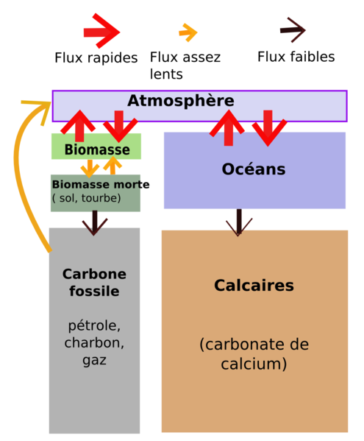
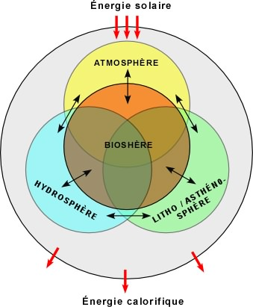
Climate is a “complex” system
Climate is a complex system
Matter, heat, chemical and biological transformations flows between lithosphere, atmosphere (stratosphere, troposphere), hydrosphere, biosphere
Very complex dynamic : from 1b years processes to a few hours time constant
CO₂ matters because it has a very complex cycle, implied in
Bioprocesses (carbon is the building brick for most know life),
Energy storage and release (partially related to previous point)
Sedimentation and volcanic activity
Water has a much simpler cycle than CO₂
Although GH power of water is higher;
Changes in CO2 concentration are larger, more persistent (100+y)
A lot of incident energy is provided by the Sun
The climate system uses this energy, to make climate going as well as life
Life and climate are closely interconnected

Slide 4
Lorenz attractor
An exemple of a complex system: Lorentz attractor https://www.youtube.com/watch?v=Tyjv-tmZg5U

Slide 5
Green House Effect is necessary
Joseph Fourier (1823) established that earth temperature should be -18°Celsius by calculating heat balance of earth system
Something has to be added in the picture
GHG and effect were discovered by Lyndall
Light and other radiation from Sun carry energy, part of it is reflected (atmosphere, clouds, albedo), part of it is absorbed by the ground.
This heat is re-emited in a different radiation (Infrared) and then captured by GHG, transparent to light radiations but absorbing infrared.
Arrhenius calculated that a doubling of CO₂ in atmosphere would increase temperature by 4°C
He produced this estimation in 1896
He thought that it was a way out of Little Ice Age

Slide 7
A timeline of climate

Slide 8
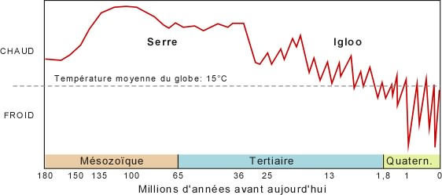
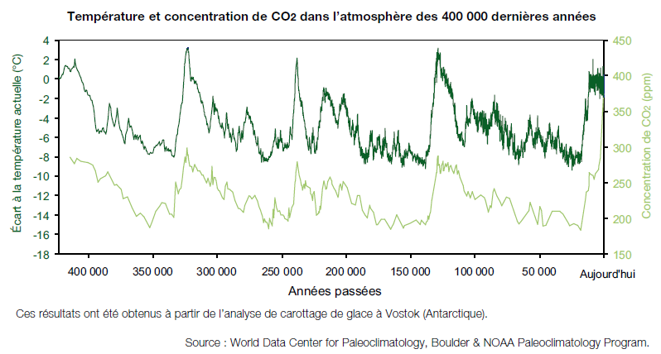
Climate has been stable… for a long time
Relatively cold and stable since a few million years
Quaternarian Ice ages, the last one ended 10k before us
Very stable since a few 100k years
8 to 10 °Celsius range
Mamal life period
Strong biodiversity impact of change in temperature
Climate has been very stable since 10k
Civilization time frame
Bioselection by human,
Colonization of the whole planet by humans
There is no causal (scientifically demonstrated) link between climate and civilization
25°C
5°C

Slide 10
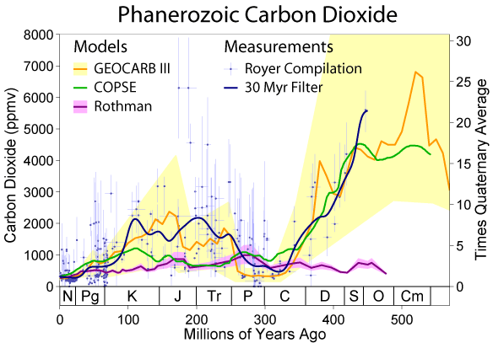
Climate and CO₂ concentration are linked
Causality is complex
The more CO₂ , the warmer the Earth (more GH effect)
The warmer the earth, the more heat is transported all around (more energy means more movment)
The more CO₂ the more oceans absorb CO₂ (the more acid they are)
The warmer earth is, the less oceans absorb CO₂
The warmer the earth is, the less aldedo reflects incoming heat (ice caps melting)
The warmer earth is, the more vegetation (or plancton) is active, the more CO₂ is absorbed by biosphere
The more acid are the oceans, the less plancton (given dominant in current pH condition species)
More CO₂ means more vegetation, but means also different vegetation, younger one
Impact on long term storage of carbon is ambiguous and complex
Speed of change is important
Biosphere can adapt differently to fast changing conditions
In the past : change in CO₂ have been triggered by change in temperature
Most probable explanation : Milankovic cycles
Change in temperature are then amplified by change in CO₂ (through GHE)

Slide 11
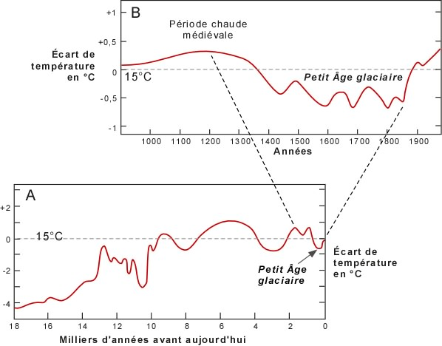
[very small] climate change had an impact on civilization
Satbilisation of climate and civilization
Ruddiman hypothesis early anthreopocen, deforestation increases CO₂ and may be some other GHG
The peak of the Roman Empire was a warm period
One could grow wine in Great Britain (or Danemark)
Dark ages were a cold period
Little Ice Age
The French Revolution is linked to bad weather and crops (due to cold and rainy summers)

Slide 12
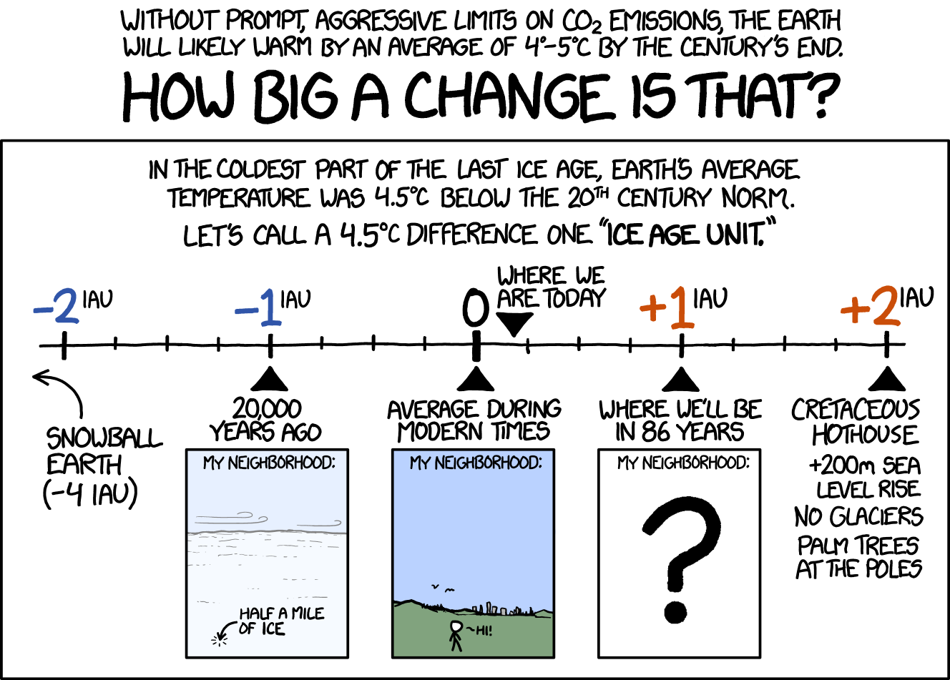
A change ?

Slide 13
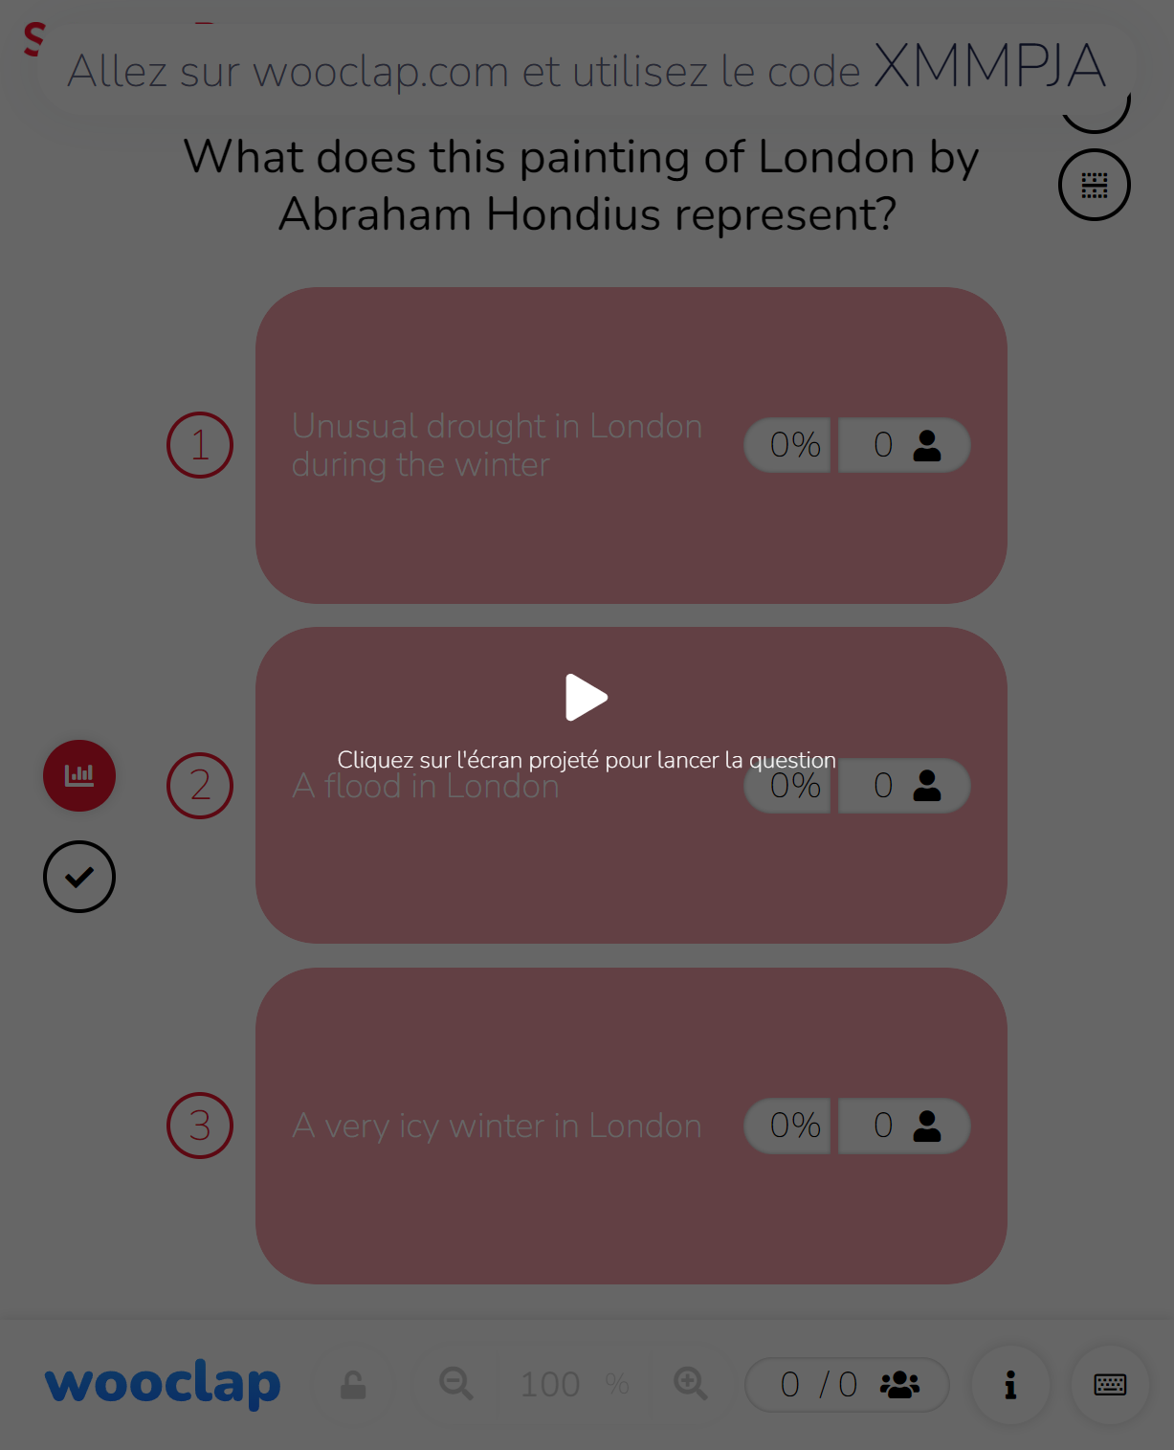
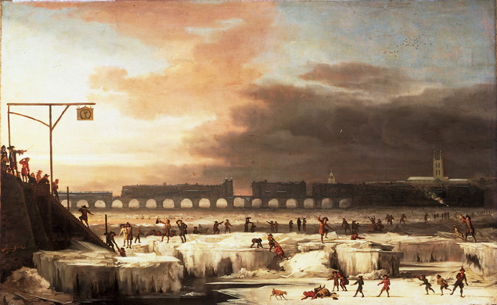
Art commentary quiz!

Slide 14
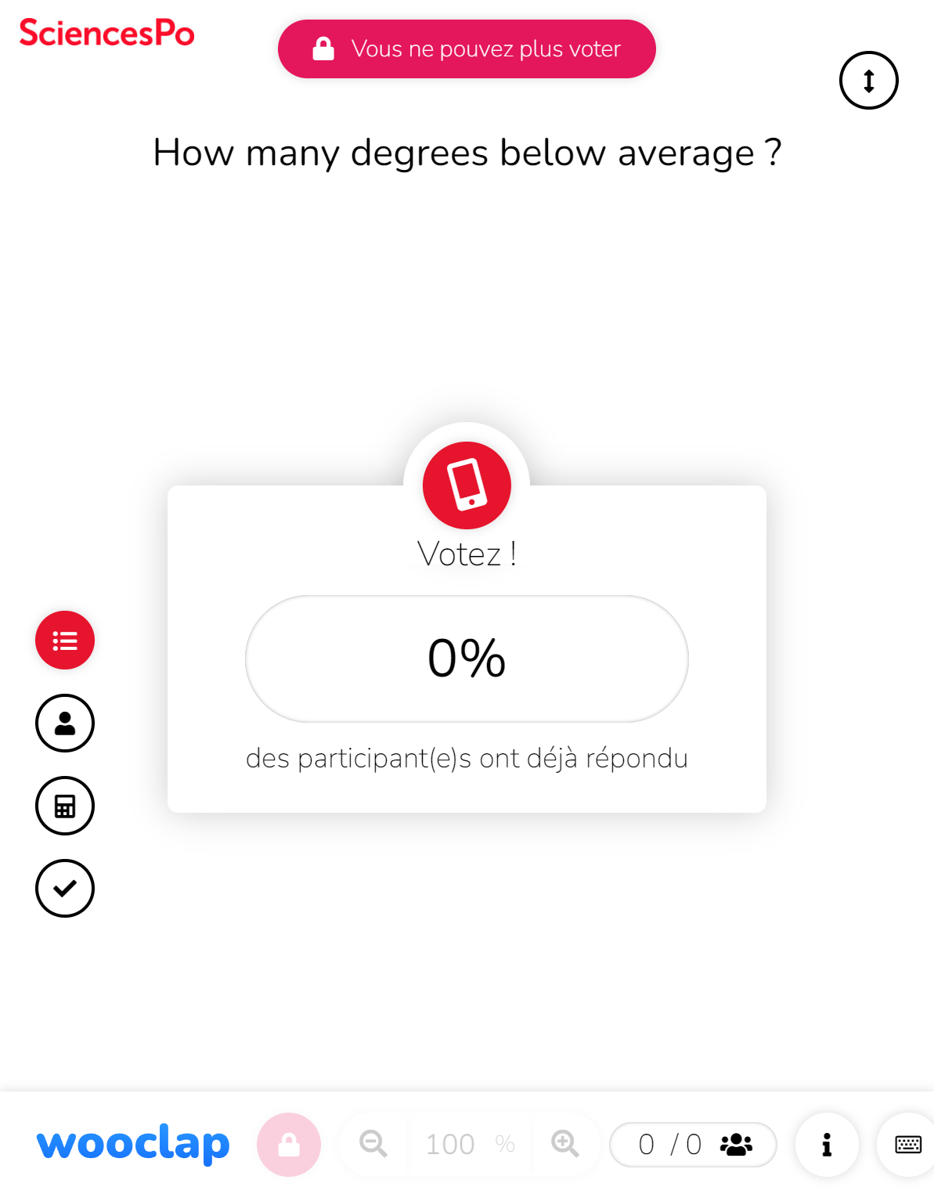
A few degrees matters!
The Frozen Thames, 1677, Abraham Hondius

Slide 15
A few degrees matters : Consequences
The Frozen Thames, 1677, Abraham Hondius

Slide 16
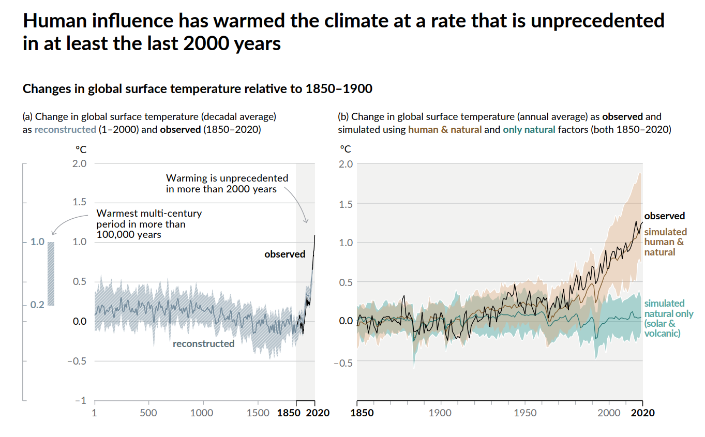
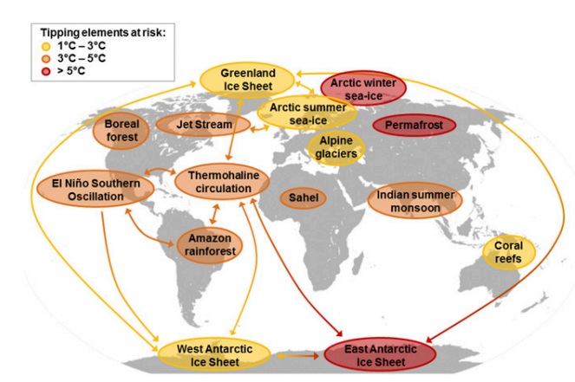
Consequences of climate change… are huge and yet partially known
Since 10k years, less thand 250ppm
Since 400k years less than 300ppm
Today 430 ppm CO₂
450 ppm equals (approx.) +2.1°C
Beyond 450 ppm no ice caps (in some time)
Non linear effects
Ocean temp. can modifiy heat transport (less heat in the North)
Release of Methane trapped in permafrost permafrost (500 Gt eq. CO2)
Release of methane trapped in deep ocean
Gulf stream perturbation (the Day After)
Uncertainty (unkonwn today)
Carbon sink retroaction
Impact on long term carbon storage (forest, shell formation, etc…)
Many more : we do not have such an experiment of a quick increase in carbon concentration
Specific process may set up
Steffen, W., Rockström, J., Richardson, K., Lenton, T. M., Folke, C., Liverman, D., … Schellnhuber, H. J. (2018). Trajectories of the Earth System in the Anthropocene. Proceedings of the National Academy of Sciences of the United States of America, 115(33), 8252–8259. https://doi.org/10.1073/pnas.1810141115

Slide 17
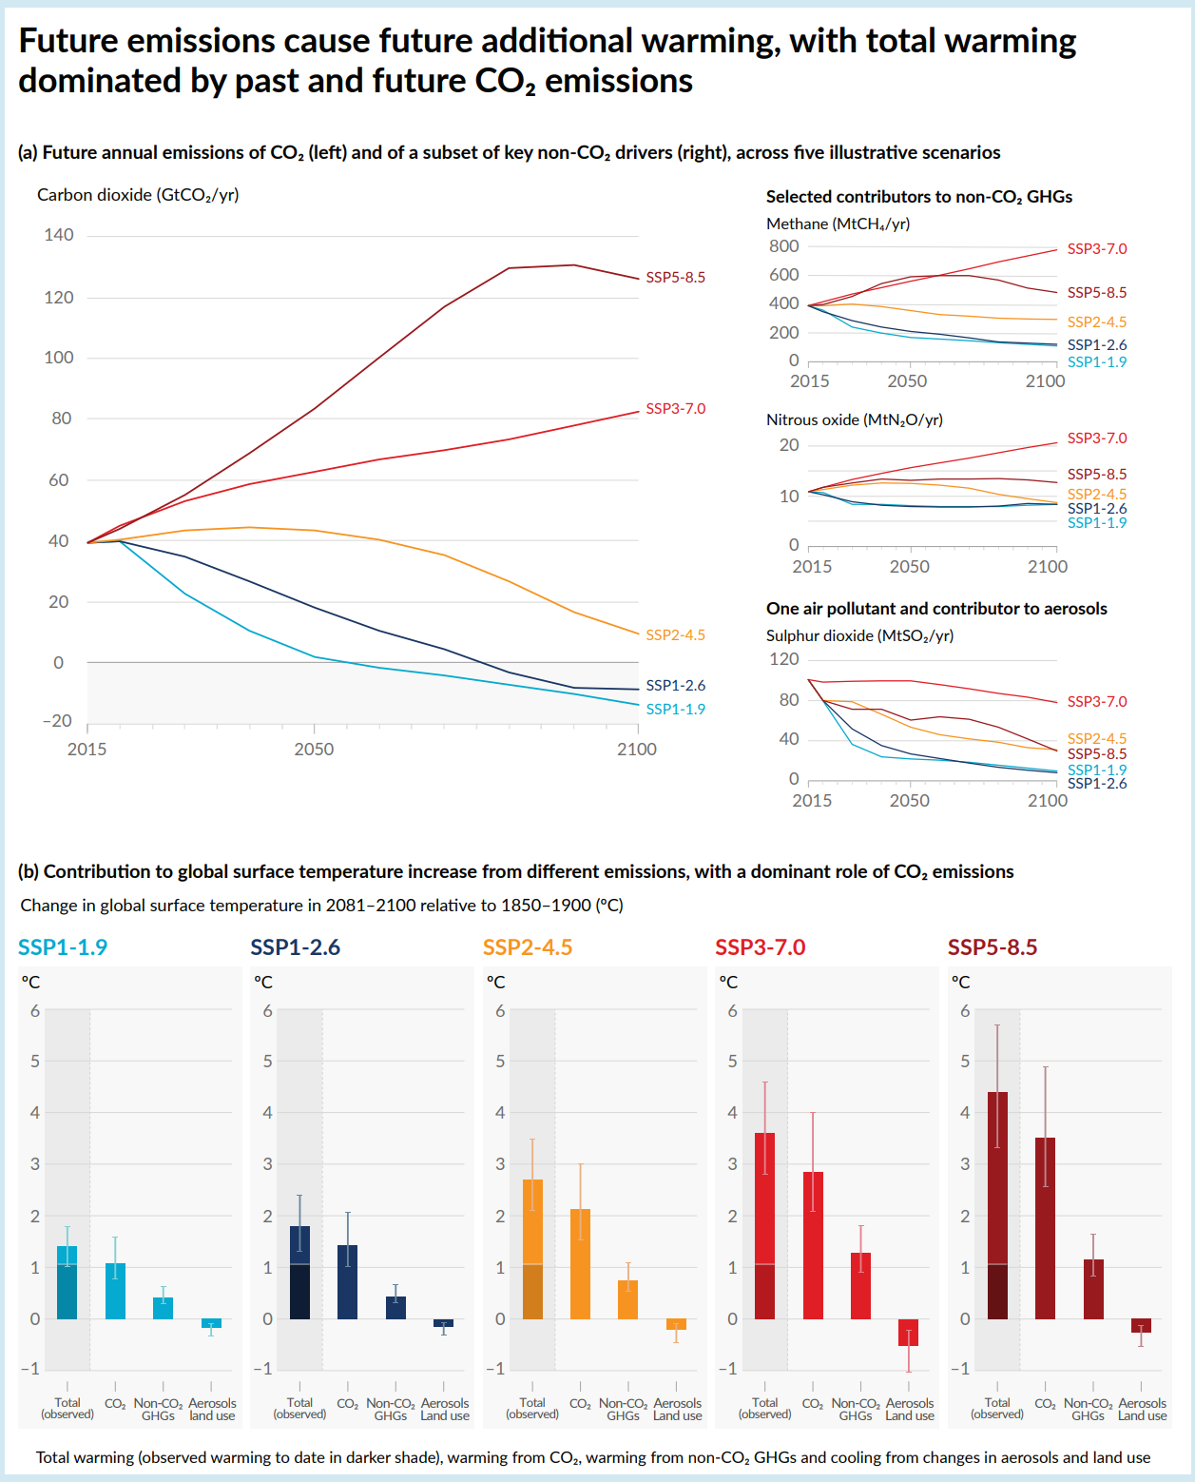
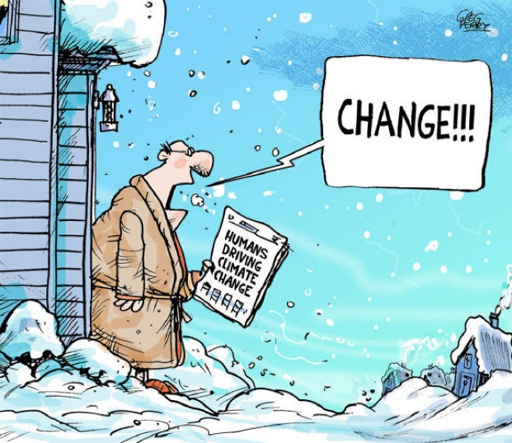
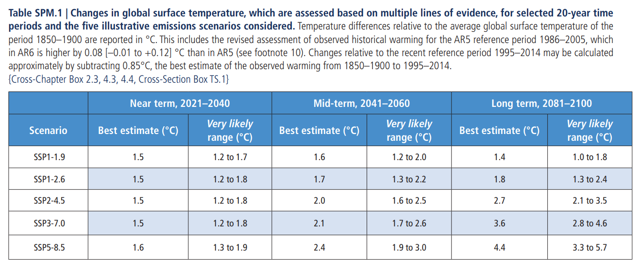
Anthropogenic forcing and scenarios

Slide 18
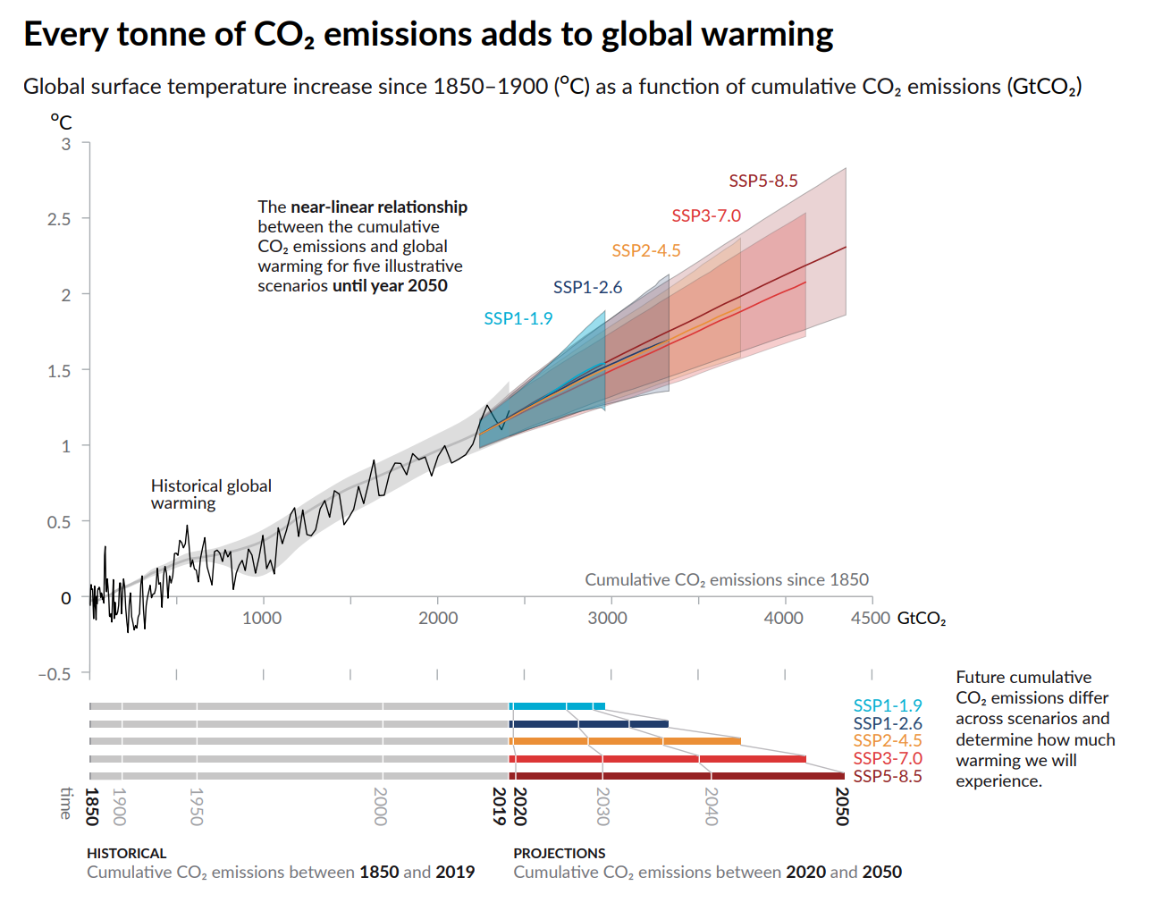
Carbon budget

Slide 19
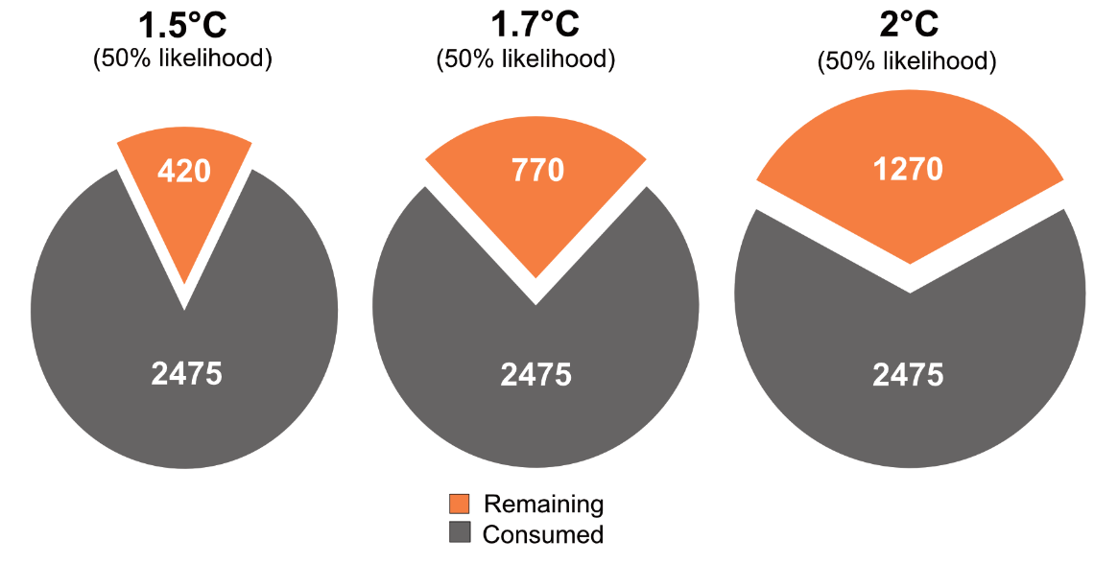
CO₂ : it can be summarized in one target
CO₂ stay a long time in the atmosphere
More than a century
eCO₂ is defined by considering GH power crossed with persistence : a flow of emission of any GHG (including water vapor) is converted in the equivalent flow of CO₂ regarding its impact on GHE for 100 years.
The planet has a certain capacity to absorb CO₂
Mainly oceans (Revelle effect, implying acidification), forests&biosphere;
know in present conditions, uncertain in changing ones
If we don’t want to go over 450 ppm, then by 2100 we have to be around 10 GtCO₂/y (cumulative emission from pre-ind to 2100 no more than 2 000 GtCO₂ [carbon budget])
450 ppm is associated with large change in climate
Although mitigation is possible
James Hansen is advocating ofr max 300 ppm (pre IR level)
Ice caps, minimize change in climate
mCO2 = 3 2/3 mC; 1PgC/y~3.6GtCO₂

Slide 20
Emissions sources and inequalities in emission

Slide 21
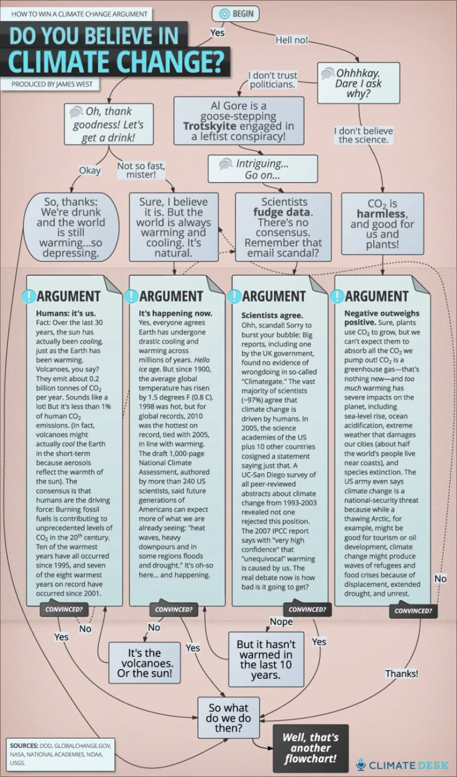
Climate change debate

Slide 22
What is the link between income and CO2 emissions
 | CF (eCO2t/p) | Population | GDP/h PPP
France | 13.1 | 60 | 33 674
Germany | 15.1 | 82 | 34 401
Italy | 11.7 | 58 | 30 353
Denmark | 15.2 | 5 | 36 130
Poland | 8.7 | 38 | 15 987
India | 1.8 | 1 032 | 2 753
China | 3.1 | 1 270 | 5 383
USA | 28.6 | 278 | 45 592
Among a sample of 70 countries, estimated elasticity is of 0.7 (simple regression, no other factors, unweighted)

Slide 23
Differents sources of CO2 data
CO2 or Carbon (mCO2 = 3 2/3 mC, mC=12, mO=16, mCO2 =44, mC = 12/44mCO2)
Main anthropogenic sources of CO2
Fossil fuel combustion, Gas Flaring
Limestone decarbonation (CaCO3->CaO+ C +2O)
Change in land usage
Other GHG
CO2 equ. is hard to define : different absortion power, different lifespan in atmosphere, different cycles and retroaction loops, different impacts in different layers of atmosphere (different lifespans and cycles also).
Base calc. is 100y eq. carbon impact on climate
 | tCO2/capita IEA | tCO2/capita WRI | tCO2/capita WRI+LU | teCO2GHG/capita
 | IEA | WRI | WRI+LU | NTNU
 | 2003 | 2003 | 2000 | 2001
World | 4.1 | 4.0 | 4.6
High income | 12.8 | 13.2 | 11.2
Middle income | 3.5 | 3.6 | 3.9
Low income | 0.8 | 0.9 | 2.4
USA | 19.5 | 19.9 | 17.0 | 28.6
France | 6.4 | 6.6 | 5.7 | 13.1
Italy | 7.8 | 8.2 | 7.5 | 11.7
Germany | 10.2 | 10.5 | 10.4 | 15.1
India | 1 | 1.0 | 0.8 | 1.8
China | 3.2 | 3.3 | 2.5 | 3.1
www.wri.org (earthtrend portal), www.worldbank.org, www.carbonfootprintofnations.com/

Slide 24
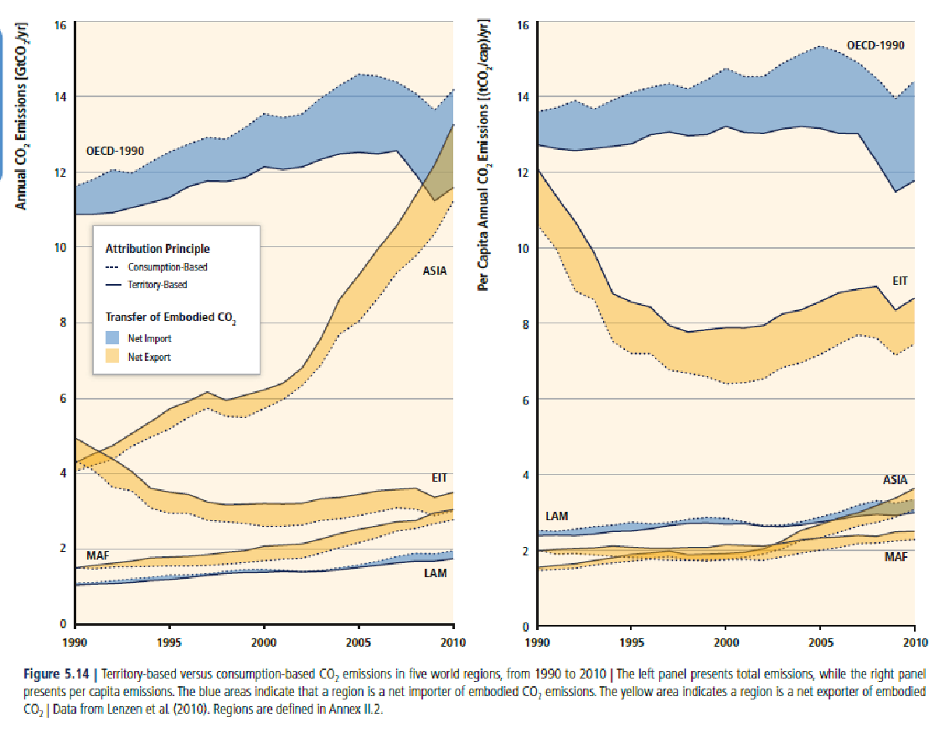
IPCC analysis of the same topic (Lenzen et al 2010)

Slide 25
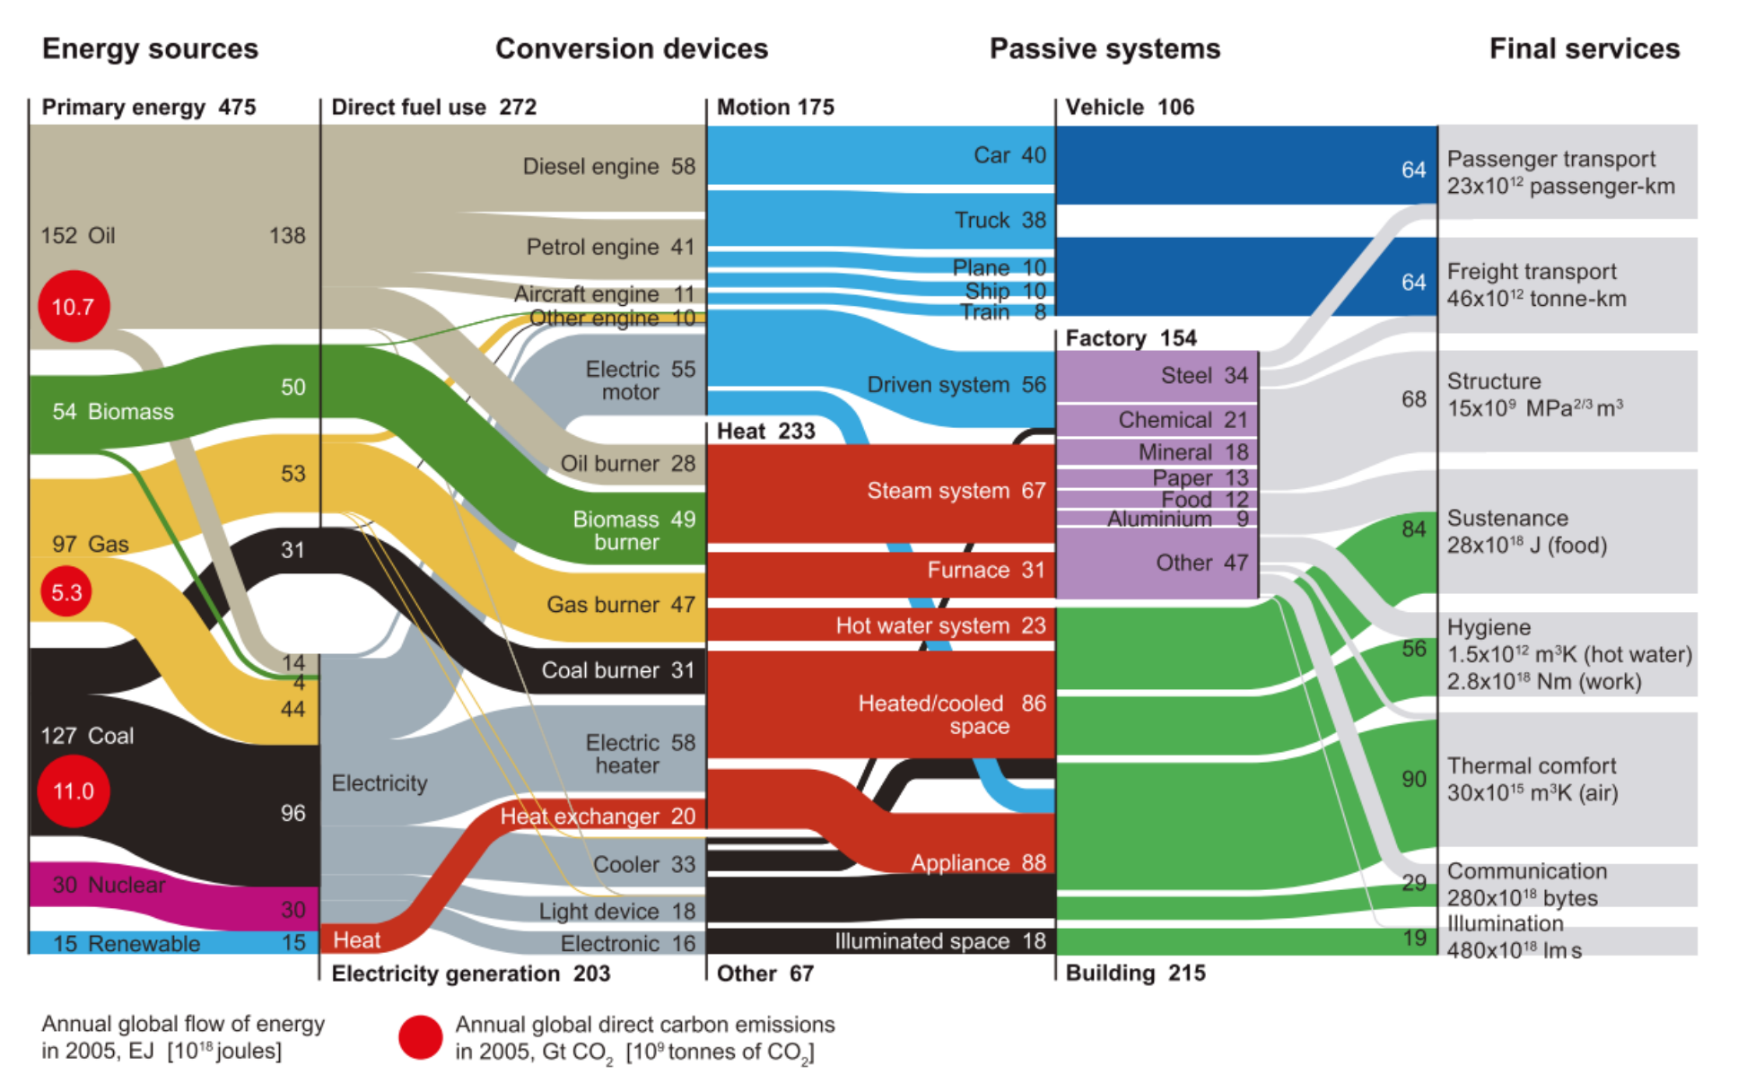
From energy to final uses
Cullen, Jonathan M, & Allwood, Julian M. 2010a. The efficient use of energy: Tracing the global flow of energy from fuel to service. Energy Policy, 38(1), 75–81.

Slide 26
Differents sources and way to account CO2
CO2 stands in the atmosphere for a long time
Cumulated make sense
Products are produced in one place and the go somewhere else
Consumer based CO2 emission or producer (use of GTAP database) Hertwich, E. G., & Peters, G. P. (2009)
 | Population | Total emissions | Total emissions (all HI) | Total emissions (all MI) | Cum. tCO2/capita | Cum./Cum. World
 | WB | IEA |  |  | WRI
 | 2005 | 2003 | 2003 | 2003 | 2005
World | 6 515 | 27Gt | 83Gt | 23Gt | 106 | 1.0
High income | 993 | 13Gt | 13Gt | 3.5Gt | 393 | 3.7
Middle income | 3 056 | 11Gt | 39Gt | 11Gt | 91 | 0.9
Low income | 2 458 | 2Gt | 31Gt | 8.6Gt | 14 | 0.1
USA | 300 | 5.8Gt | 3.8Gt | 1.0Gt | 609 | 5.7
France | 61 | 0.4Gt | 0.8Gt | 0.2Gt | 257 | 2.4
Italy | 59 | 0.5Gt | 0.8Gt | 0.2Gt | 234 | 2.2
Germany | 83 | 0.8Gt | 1.1Gt | 0.3Gt | 475 | 4.5
India | 1 134 | 1.1Gt | 15Gt | 4Gt | 17 | 0.2
China | 1 313 | 4.2Gt | 17Gt | 5Gt | 59 | 0.6

Slide 27
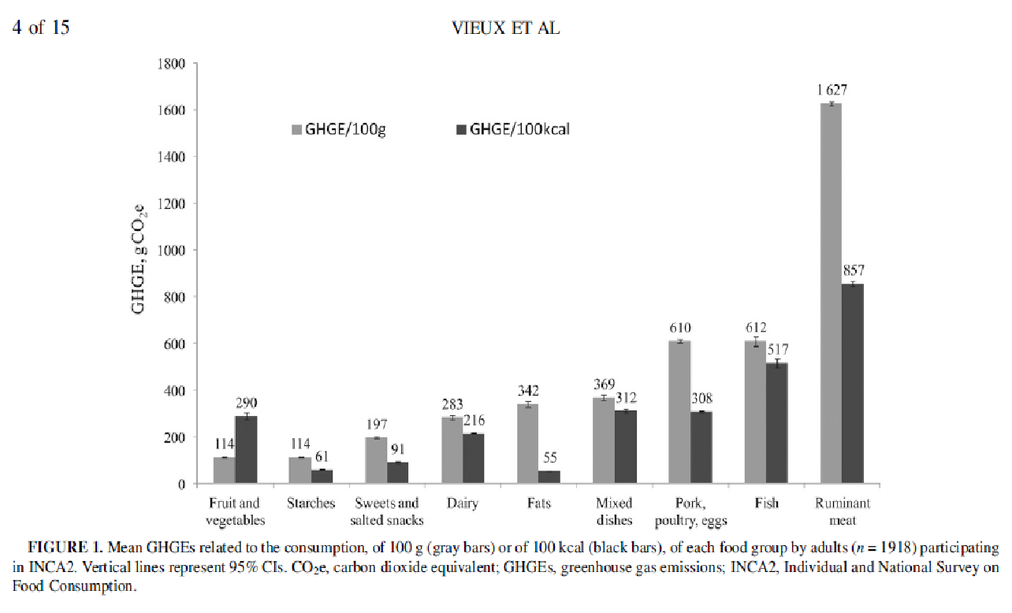
From where comes CO2 emissions
When based on final usage, one can split CO2 emission to usage
Food accounts for around 15 to 20%
Shelter maintenance and operation for another 20%
Mobility is around 20%
Goods&services production is around 30%
For a sharp reduction of emission, all usages have to reduce
The case for food
All vegetarian/vegan could reduce food emissions by 30%
Fat and Amidon/Feculent are the most efficient diet
Pork/Poultry equivalent to fruits in terms of GHG/kcal
The Italian diet is a reference
Vieux F., Soler L., Touazi D. and Darmon N., 2013. "High nutritional quality is not associated with low greenhouse gas emissions in self-selected diets of French adults 1 – 3", (9). doi:10.3945/ajcn.112.035105.
 | CF (eCO2t/p) | Population | construction | shelter | food | clothing | Manufactured products | mobility | service | trade
France | 13.1 | 60 | 1.0 | 2.5 | 2.1 | 0.4 | 2.1 | 2.5 | 2.1 | 0.5
Germany | 15.1 | 82 | 1.2 | 3.3 | 2.0 | 0.6 | 1.7 | 3.3 | 2.6 | 0.8
Italy | 11.7 | 58 | 1.1 | 1.9 | 1.6 | 0.5 | 1.8 | 2.6 | 2.1 | 0.9
Denmark | 15.2 | 5 | 1.7 | 3.6 | 1.8 | 0.6 | 1.5 | 5.2 | 2.7 | 0.8
Poland | 8.7 | 38 | 0.5 | 2.7 | 1.6 | 0.1 | 0.9 | 1.4 | 1.1 | 0.7
India | 1.8 | 1 032 | 0.1 | 0.3 | 0.7 | 0.1 | 0.2 | 0.2 | 0.2 | 0.1
China | 3.1 | 1 270 | 0.8 | 0.4 | 0.8 | 0.1 | 0.3 | 0.2 | 0.5 | 0.1
USA | 28.6 | 278 | 2.0 | 7.2 | 2.3 | 0.9 | 3.4 | 6.0 | 4.6 | 2.3

Slide 28
Inequalities and emissions

Slide 29
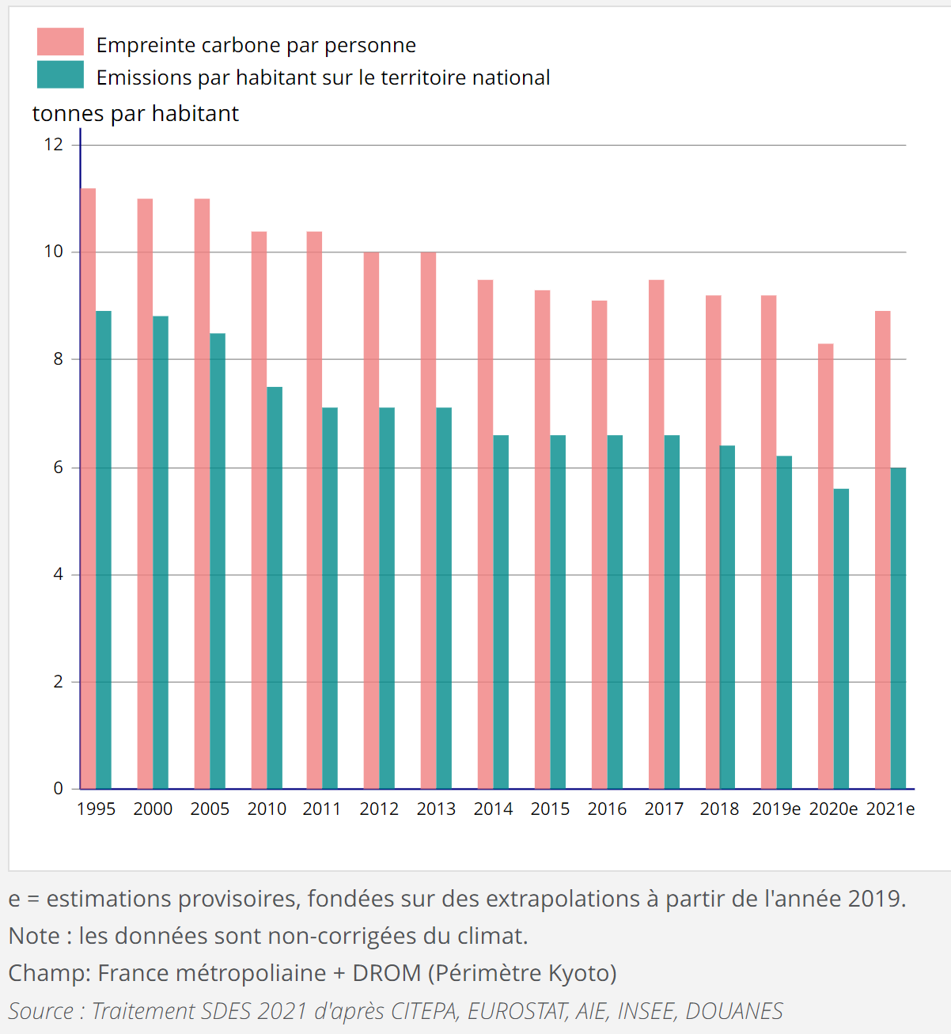
French carbon footprint

Slide 30
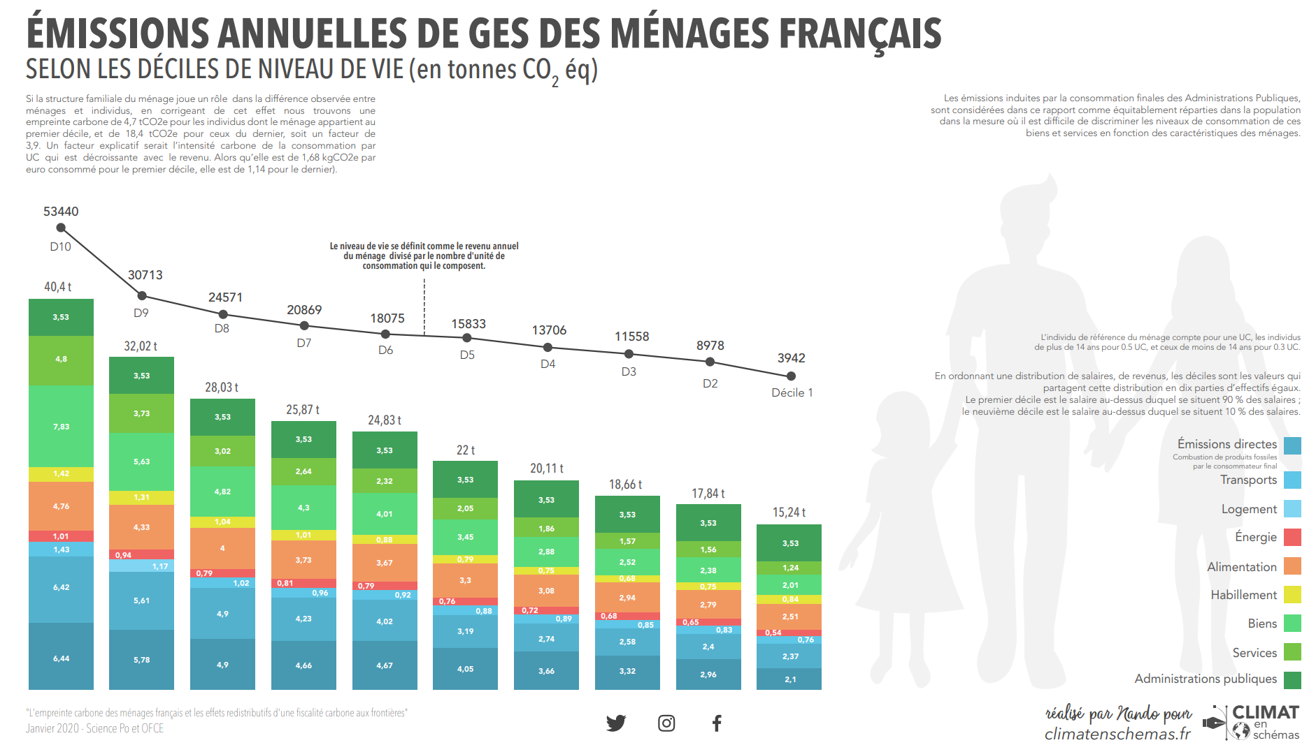
French footprint by income (households)

Slide 31
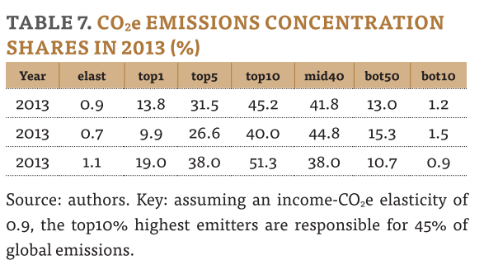
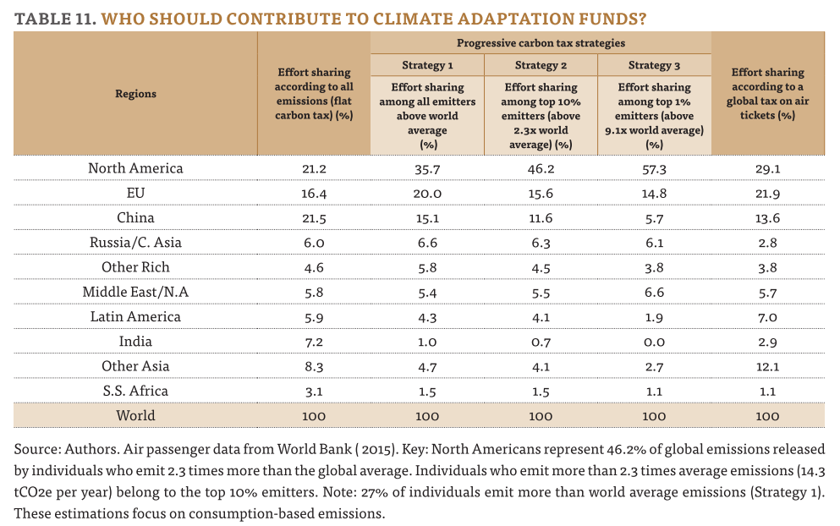
Piketty and Chancel 2015 on distribution of CO₂e emissions
Chancel L. and Piketty T., 2015. "Carbon and inequality : from Kyoto to Paris", (PSE working paper, November).

Slide 32
Chancel 2021
No more income elasticity but a consumtion eleasticity
But imputation of capital investiment to owners!
In contradiction with the consumer based approach where emissions are imputed, including capital cost
No double count (because overall emissions are redistributed) but a high share of emissions are imputed to the wealthiest due to the share in wealth : 70% of the footprint of the latest decile is from wealth
Make a large diff. For highest deciles and even more for shares
Source | Coverage | Emissions last decile | Share of last decile | link
Piketty Chancel 2015 | France | 30.5/ind | 32% | ChancelPiketty2015.pdf (hal.science)
Chancel 2021 | Europe | 32-38/ind |  | Global carbon inequality over 1990–2019 | Nature Sustainability
Theine et al 2022 | Austria | 38/household 17/ind |  | Emissions inequality: Disparities in income, expenditure, and the carbon footprint in Austria | Elsevier Enhanced Reader
Malliet 2020 | France | 38/household 18/ind | 16% | La contribution des émissions importées à l’empreinte carbone de la France (sciences-po.fr)

Slide 33
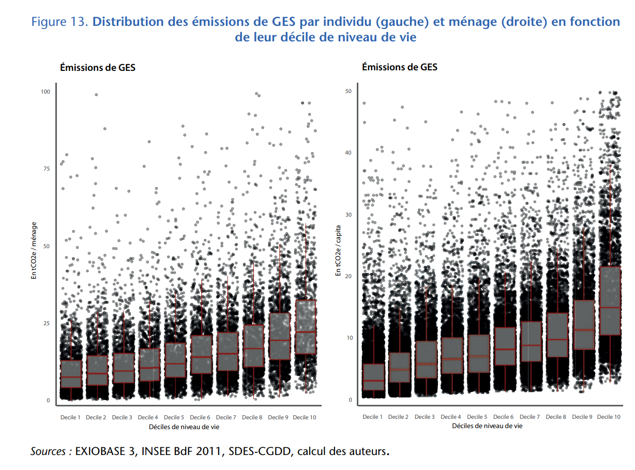

Slide 34
Heterogeneity of climate change

Slide 35
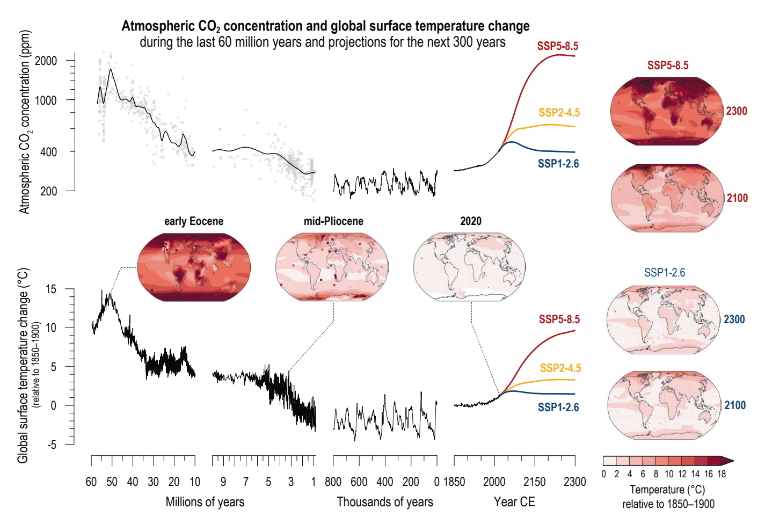
The million year perspective

Slide 36
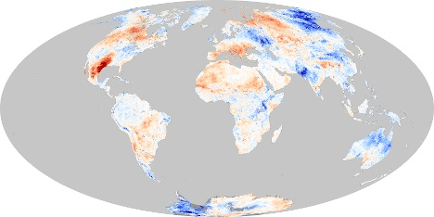
With a lot of geographic/time variability
Land Surface Temperature Anomaly
Sea Surface Temperature Anomaly

Slide 37
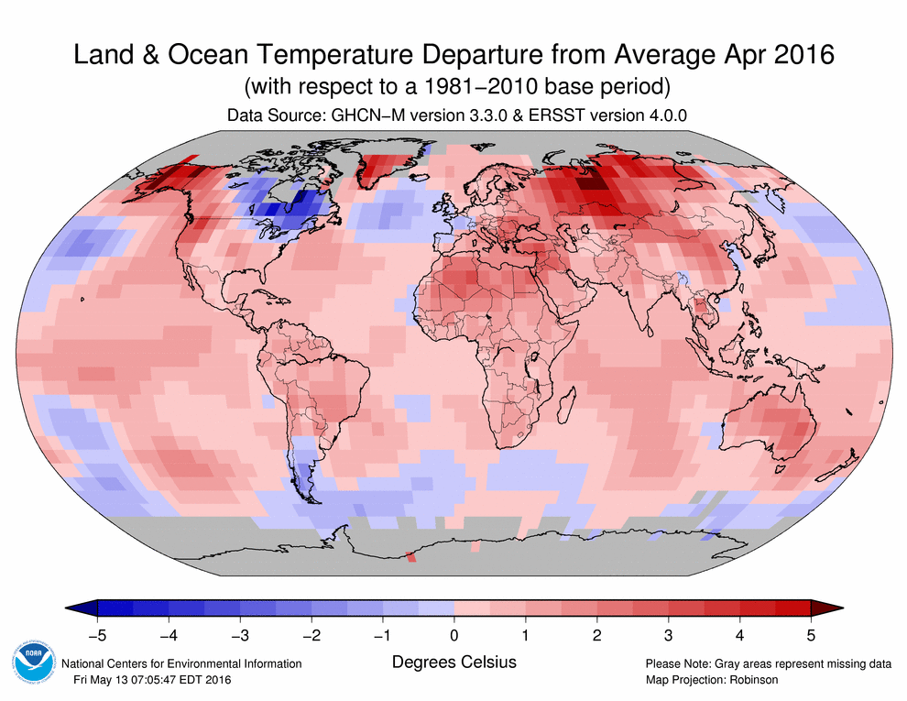
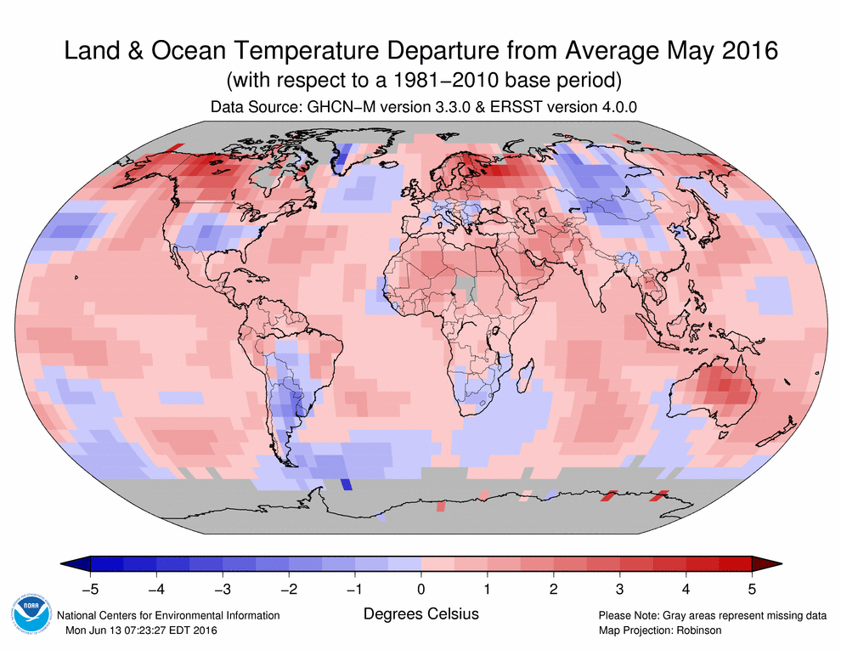
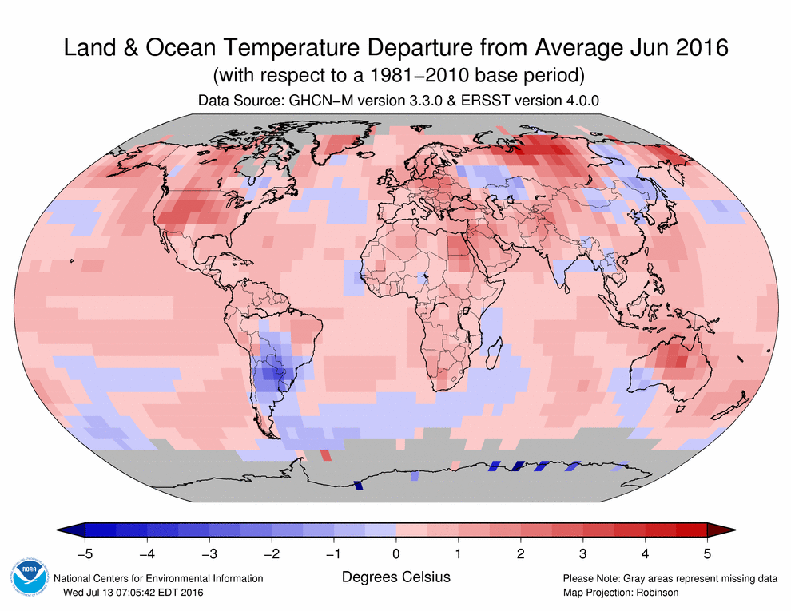
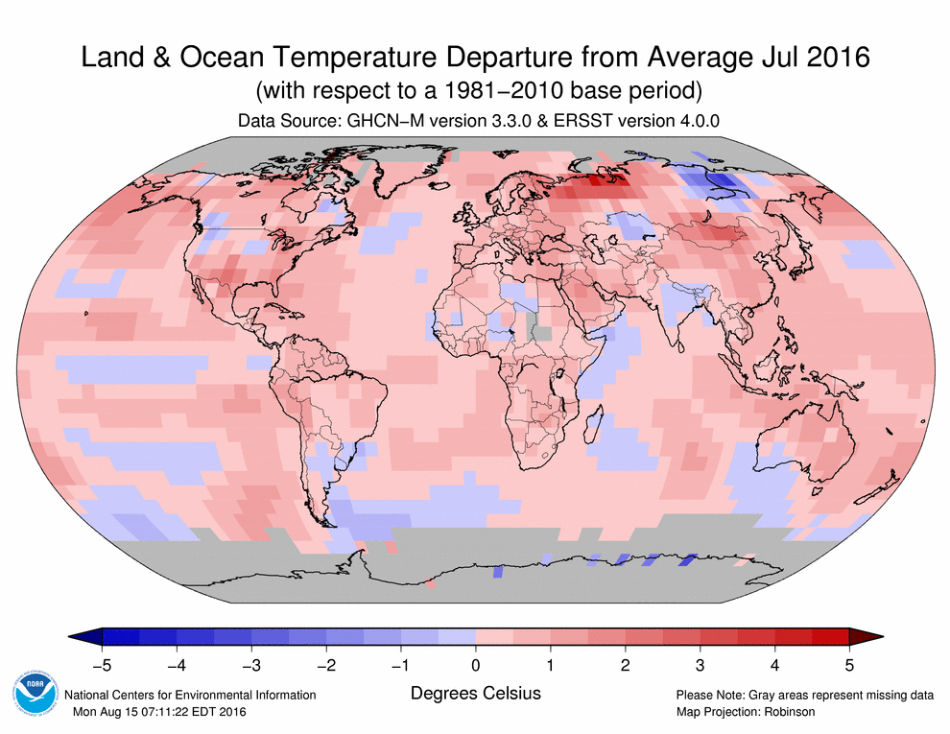
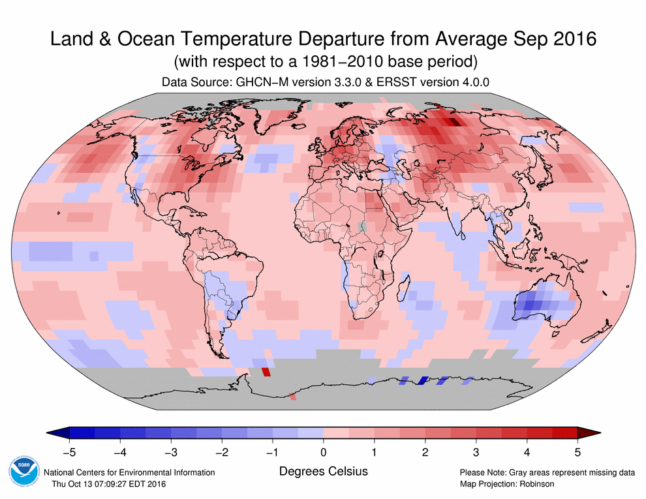
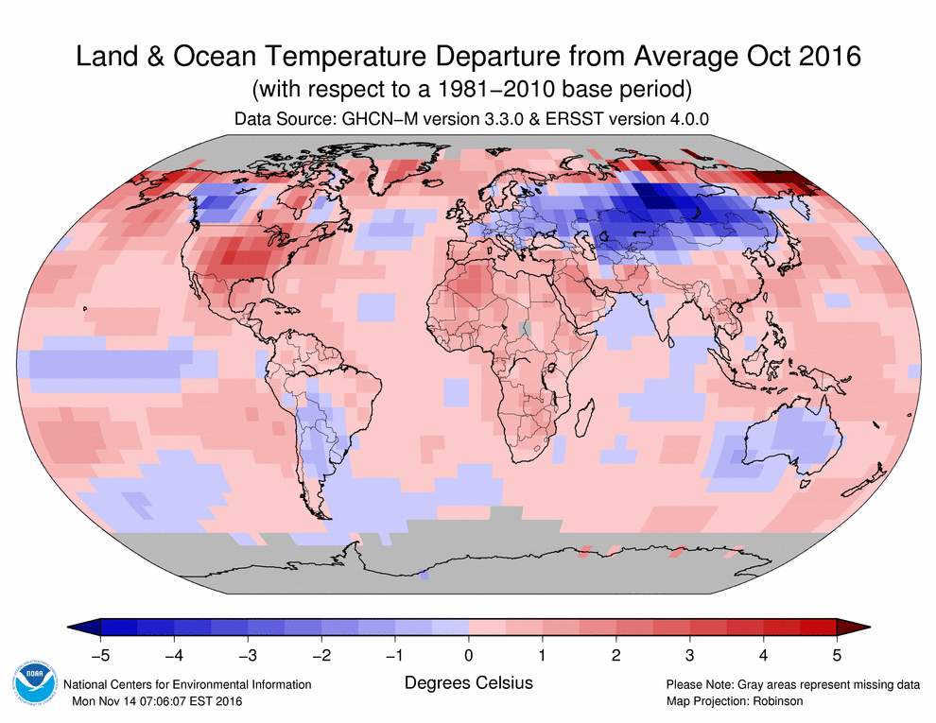
Globally hotter, but sometimes colder

Slide 38
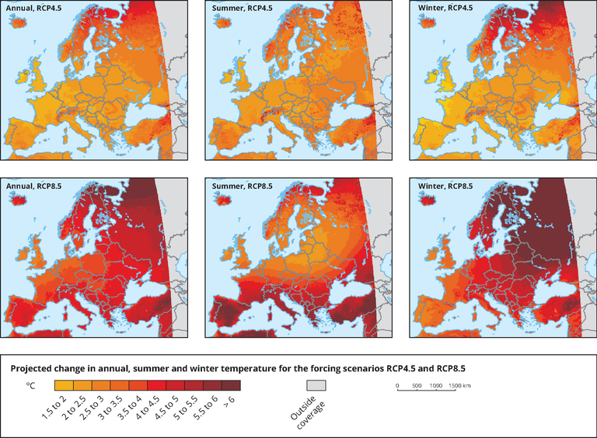
And more to come
Projected changes in annual (left), summer (middle) and winter (right) near-surface air temperature (°C) in the period 2071-2100, compared to the baseline period 1971-2000 for the forcing scenarios RCP 4.5 (top) and RCP 8.5 (bottom). Model simulations are based on the multi-model ensemble average of RCM simulations from the EURO-CORDEX initiative.

Slide 39
Geographical variability of climate is not well forecasted
Average temperature anomaly, according to 4 models, intermediate emission scenario, http://www.drias-climat.fr

Slide 40
Geographical variability of climate is not well forecasted (2)
#heat wave days anomaly, according to 4 models, intermediate emission scenario, http://www.drias-climat.fr

Slide 41
Consequences and damages

Slide 42
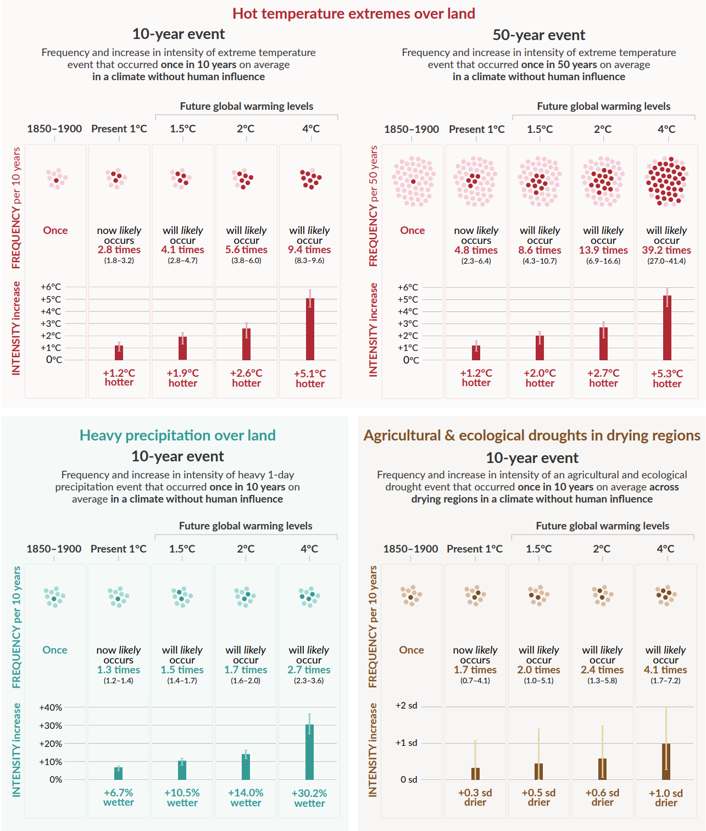
Anyhow, some consequences can be anticipated
550 ppm CO2 brings +3°C (global temp.) in the long term
never seen since a few million years (when dinosaurs were ruling)
Large geographical variability (it is why we speak of climate change and not of global warming)
Really warmer at the poles : +20°C
No more pole ice cap, less ocean large currents
Heat transport is going to be modified
Events like tempest, strenght of tempest, #days with extreme temp, #consecutive dry days, #consecutive wet days, extreme rainfall, extreme cold may become more probable
Models are still uncertain (giving different results)

Slide 43
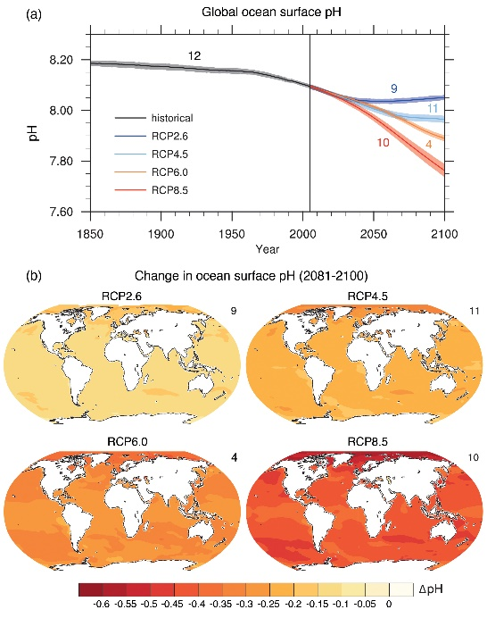
Which has consequences for life on earth
Higher CO₂ lower pH of oceans
Plancton (the one we know) is very sensitive to pH : mass extinction of plancton
consequences on agriculture
Globaly lower yield
Localy more complex : from collapse to adpation
More extreme events means lower adaptation of human selected species
consequences on ecosystems
Providing services to human beings : (for instance) 2b people depend on wild fish for protein intake
Interactions between human life and ecosystems
Services, ranging from food production to other materials supply, natural protection (habitat, protection from weather), filtration and recycling capacity or cultural base
Negative interactions (main cities in warm countries are above insects prefered altitude, which is determined by temperature. Should temp. Increase, then insects and humans would have to live more and more together, for the better and the worse)

Slide 44
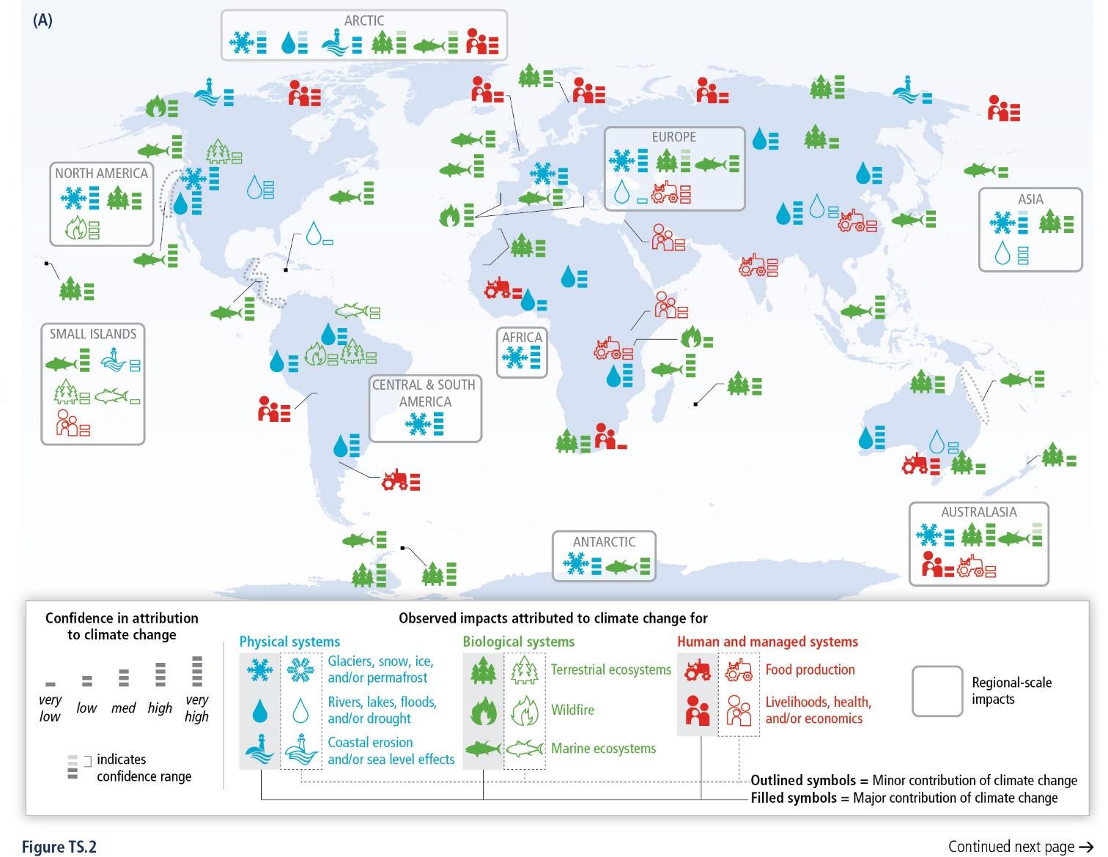
Impact of climate change

Slide 45
Evaluation of damages : PESETA IV from the JRC

Slide 46
Evaluation of damages : PESETA

Slide 47
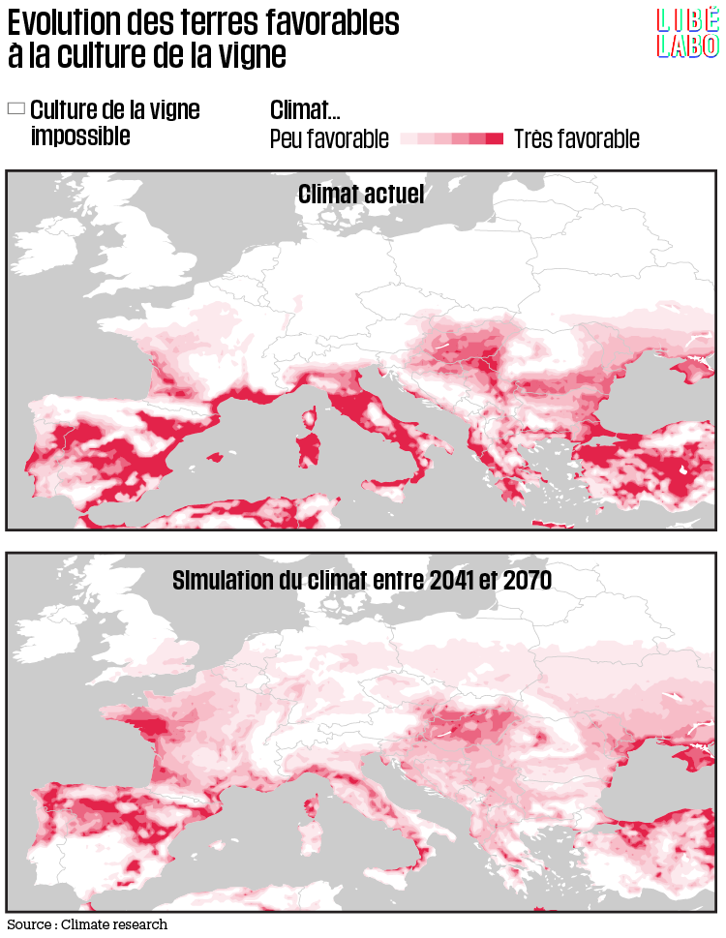
With serious consequences as well…

Slide 48
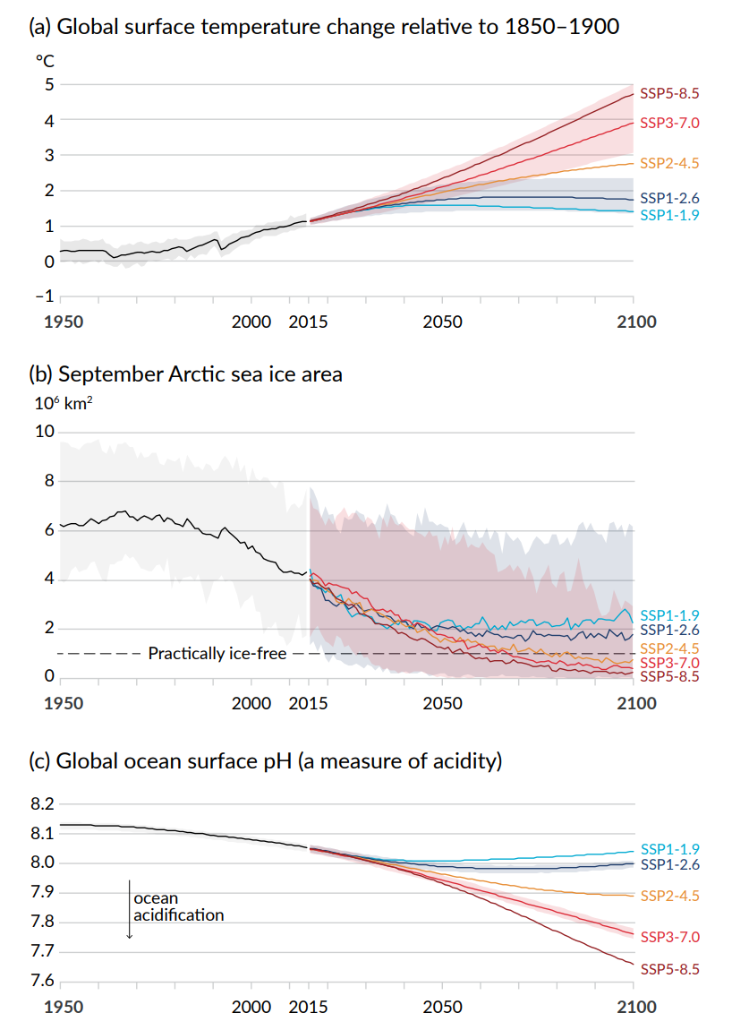
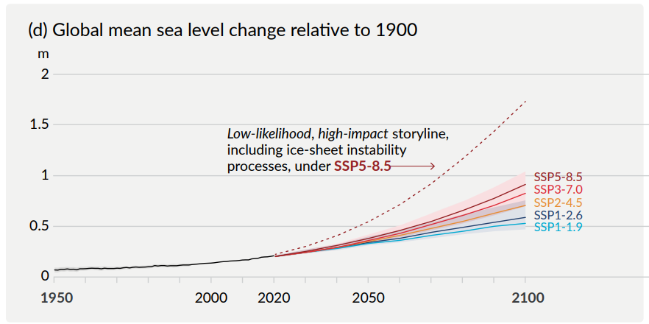
Oceans level
For now, below perception level
A few (50) mm
According to IPCC 2007 : 18 to 59 cm in 2100
But recently (since 2007)
Accelerated melting of ice
Revised estimation (IPCC 2014) up to 1.0 meter in 2100
In the long term, no more ice caps
Sources of potential sea level rise
Thermal expansion of the oceans | 0.2-0.4 m per degree C^{[1]}
Mountain glaciers and ice caps | 0.15-0.37 m^{[2]}
Greenland Ice Sheet | 7.3 m^{[3]}
West Antarctica Ice Sheet | 5 m^{[4]}
East Antarctic Ice Sheet | 52 m^{[4]}

Slide 49
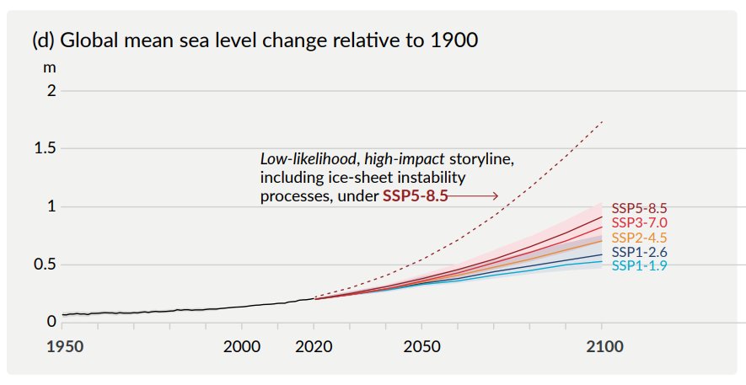
Seapocalypse

Slide 50
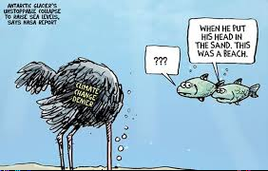
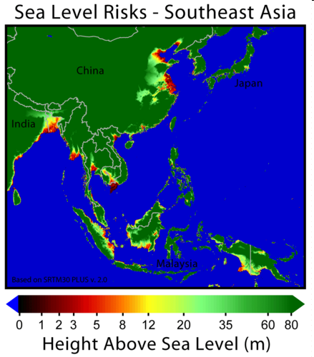
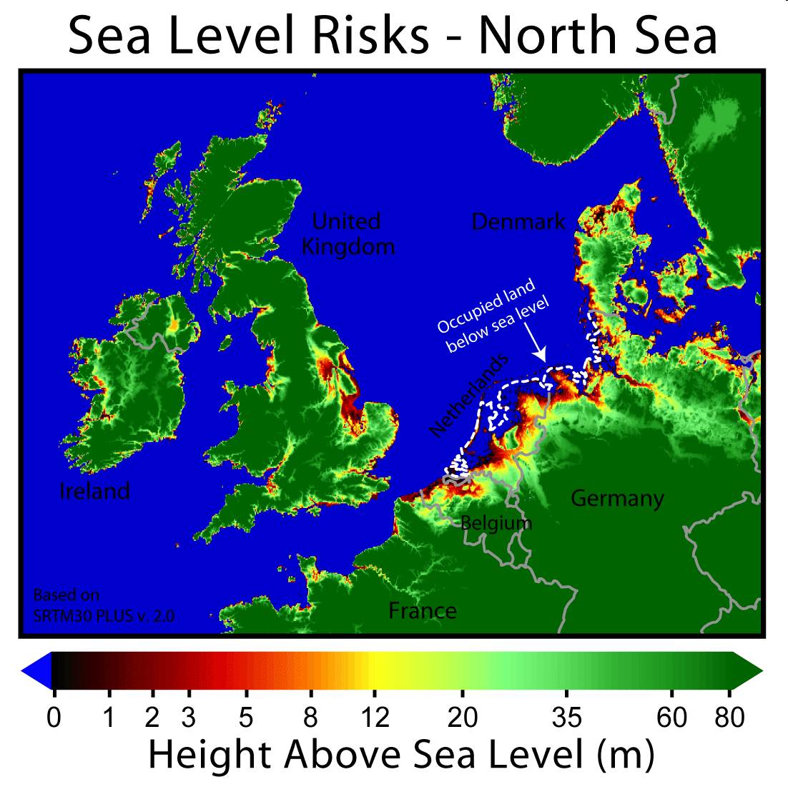
Oceans rise is…visual

Slide 51
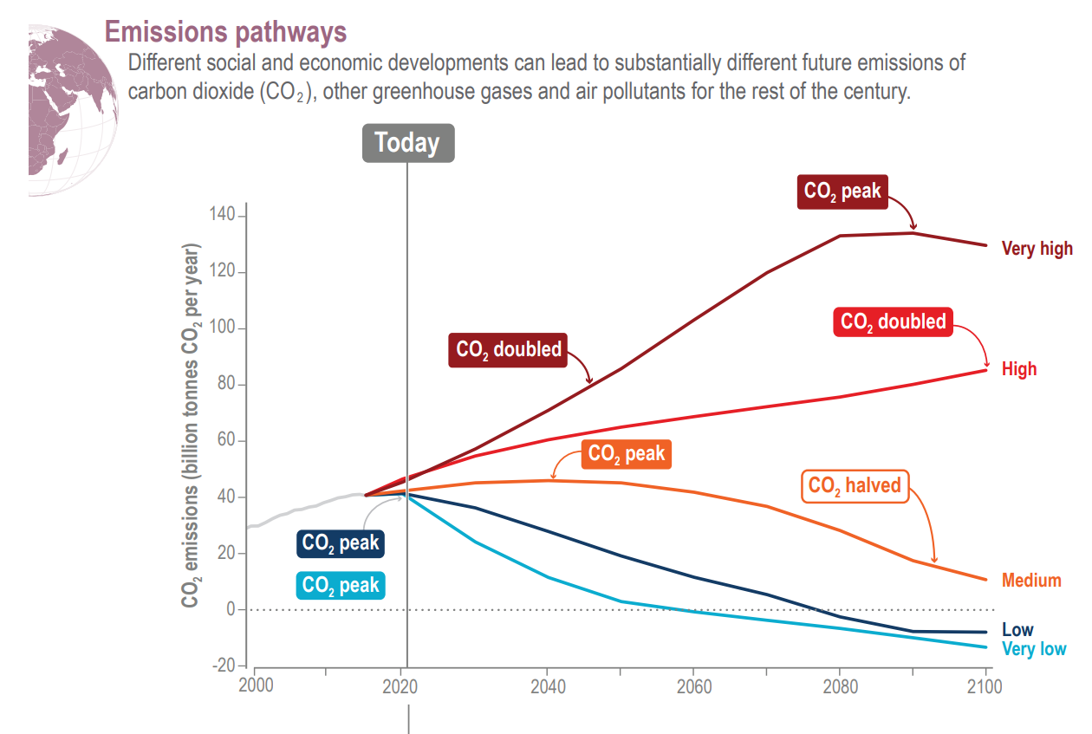
But impose a strong constraint (stronger and stronger) on GHG emissions

Slide 52
Deniers

Slide 55
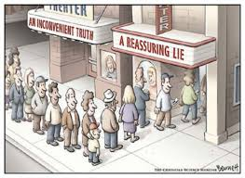
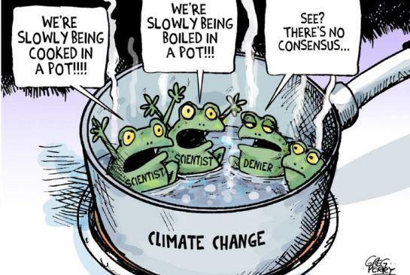
Climatosceptics
Climate gate
Emails showing data manipulation (temperature data)
Overstating ice melting in central asia
Communication war
There are some very strong anti climate policies adversary (oil producers for instance)
There are some very powerful pro climatechange policies parties (greenpeace)
Is Climate study a science ?
Not a full experimental science
Models are not validated by experiment, earth is too large
Model uncertainty
Do we model the right mecanisms (for instance, cloud modelization is still poor)
Can we predict ? Lorentz work and chaos theory states that complex dynamic system may not be deterministic. This objection is still to be adressed
Measure is complex (in peculiar paleo climatology)
Global climate is hard to define; noise, variance
Recent measurment leads to complex conclusions : groenland temperature have been highly volatil, what does this means ?
Action and knowledge theory
There is no perfect knowledge
You don’t need perfect knowledge to engage policies

Slide 56
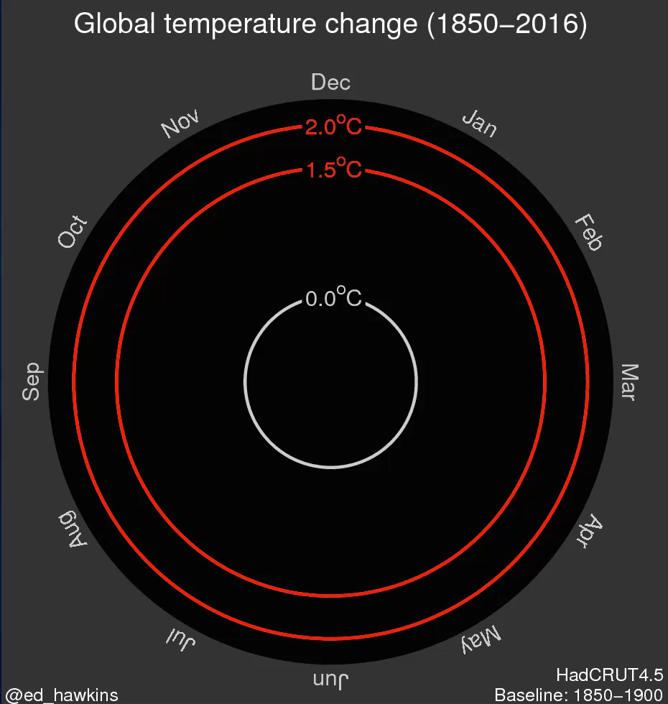
Global Temperature is already higher

Slide 58
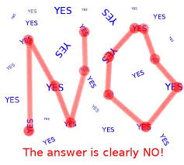
Climate change and opinion
France
France

Slide 59
Climate change and opinion: US case

Slide 60
The gap between science and public

